Slide 1
Applying Kalman Filter
Issue: Measurements come in at different times
Solution
Use only 1 sensor (IMU, GPS)

Slide 2
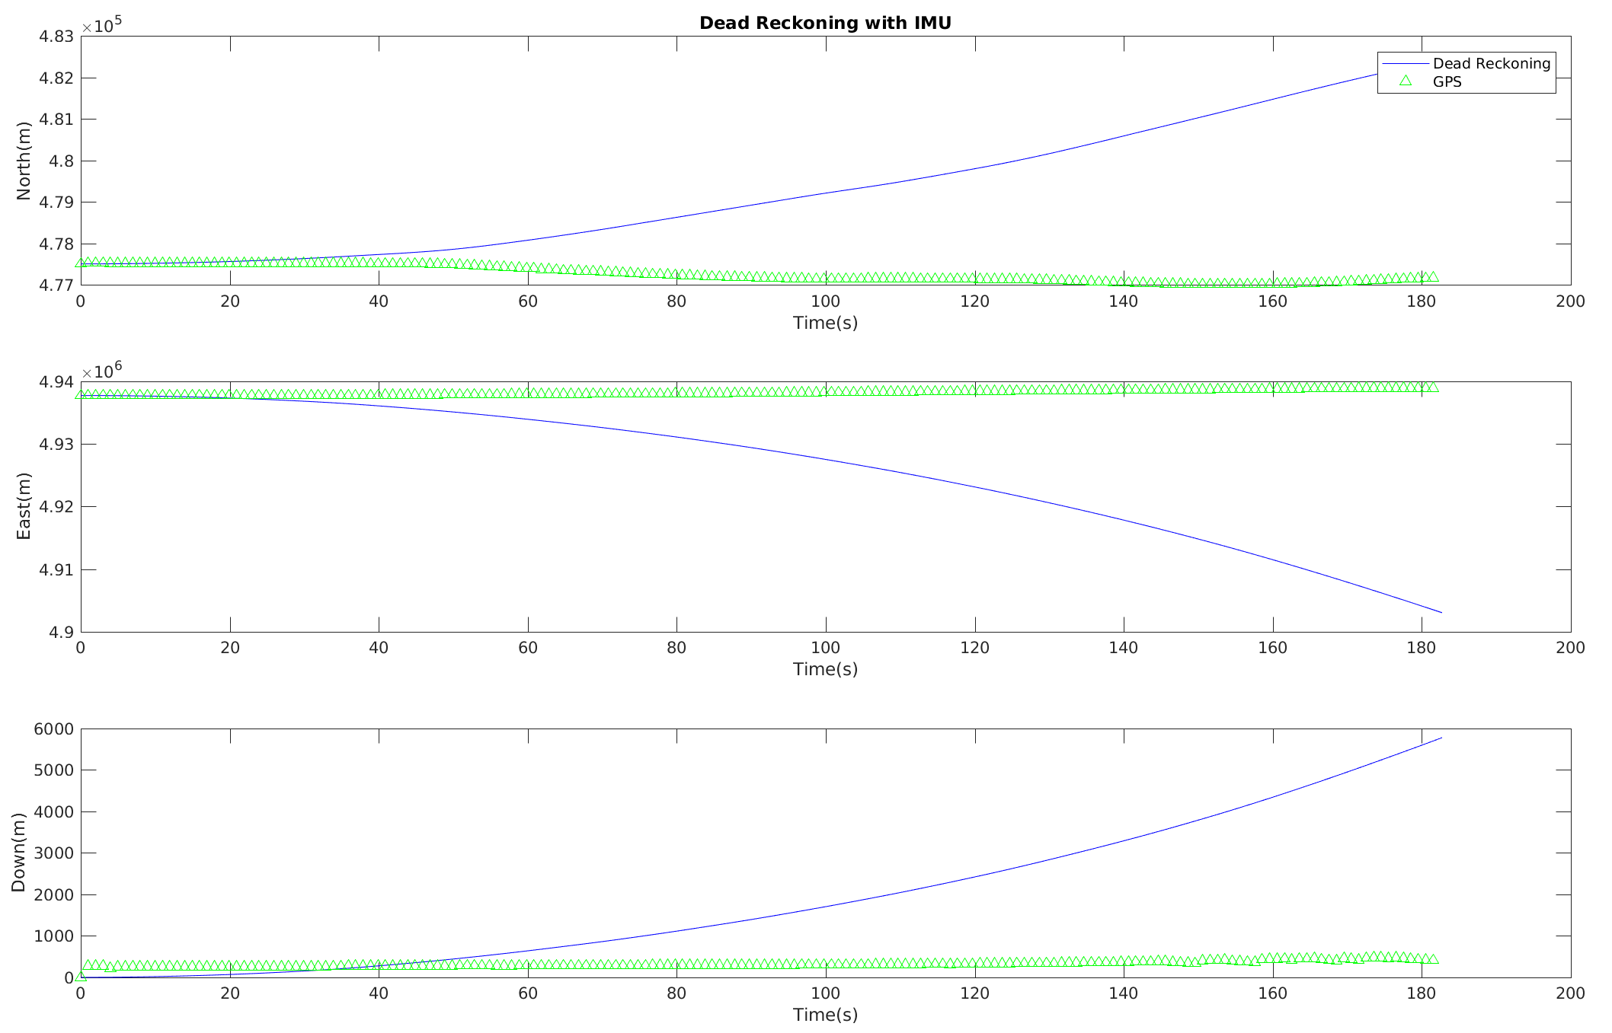
1 Sensor
Notes:
Choose GPS!

Slide 3
Applying Kalman Filter
Issue: Measurements come in at different times
Solution
Use only 1 sensor (IMU, GPS)
Integrate between GPS measurements with IMU

Slide 4
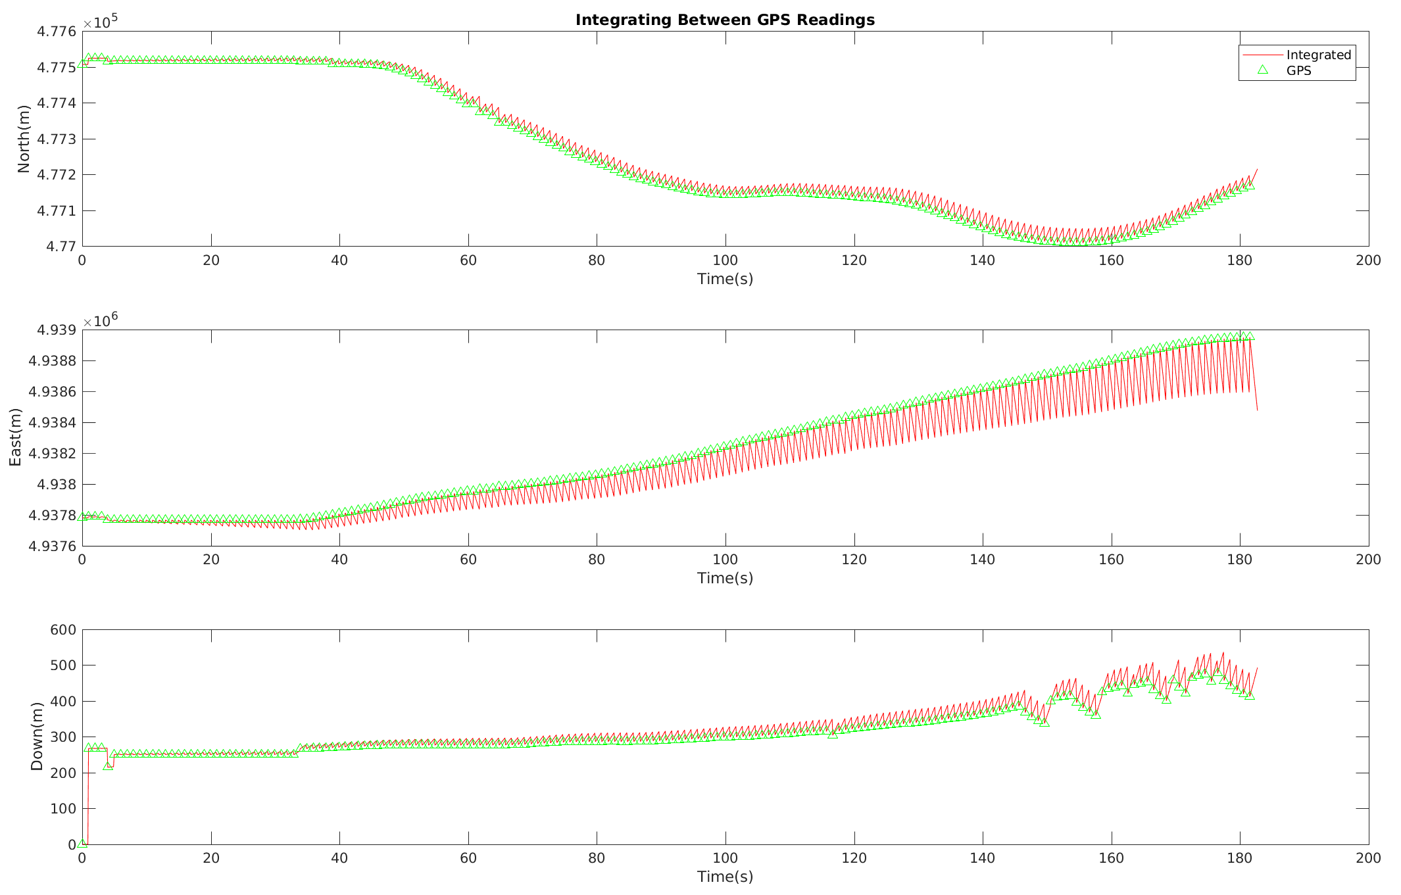
Integrate Between Sensors
Notes:
Bias and errors of the IMU are not really predicting motion correctly

Slide 5
Applying Kalman Filter
Issue: Measurements come in at different times
Solution
Use only 1 sensor (IMU, GPS)
Integrate between GPS measurements with IMU
Estimate Position with Kalman Filter
KF over GPS readings
KF over GPS readings and IMU
Predict GPS position between readings with KF

Slide 6
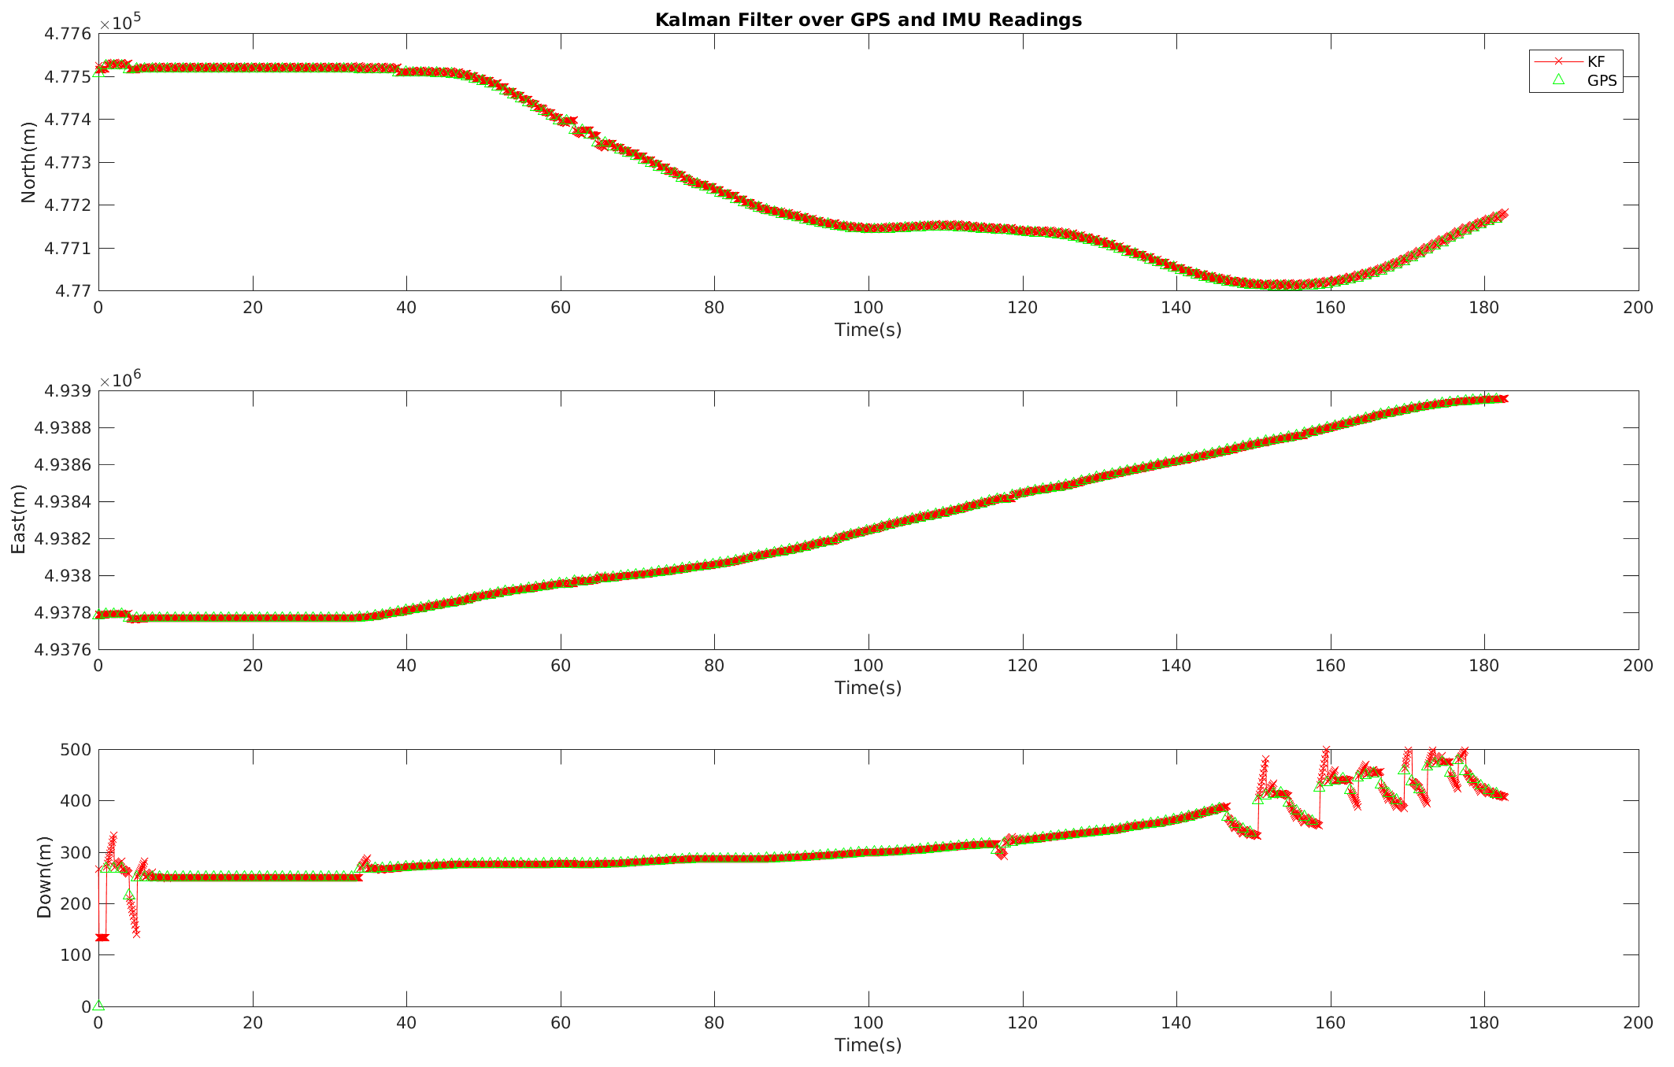
Kalman Filter with GPS and IMU Information
Notes:
Better than integrating

Slide 7


Applying Kalman Filter - Flow
Initialize
(State, Covariance)
Predict State and Covariance
Compute GPS Kalman Gain
($H_{GPS},R_{GPS)}$
Compute IMU Kalman Gain
($H_{GPS},R_{GPS)}$
GPS measurement
Compute estimate
Compute estimate
IMU measurement
Compute Covariance
Notes:
Any measurement at any time can be used, just need more H,R matrices

Slide 8
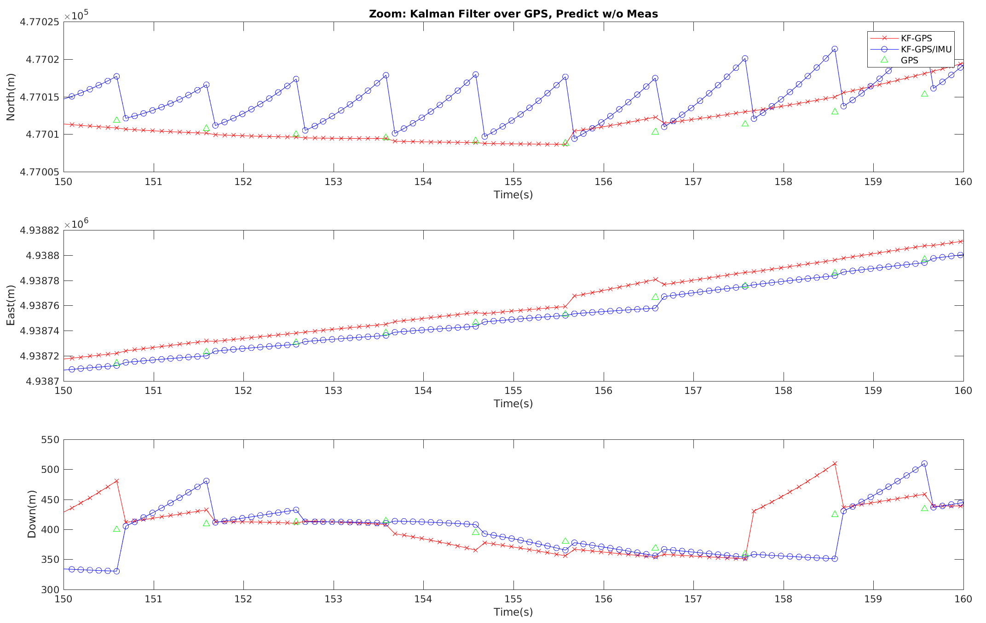
Kalman Filter - Comparison
Notes:
Bias and errors of the IMU are not really predicting motion correctly

Slide 9
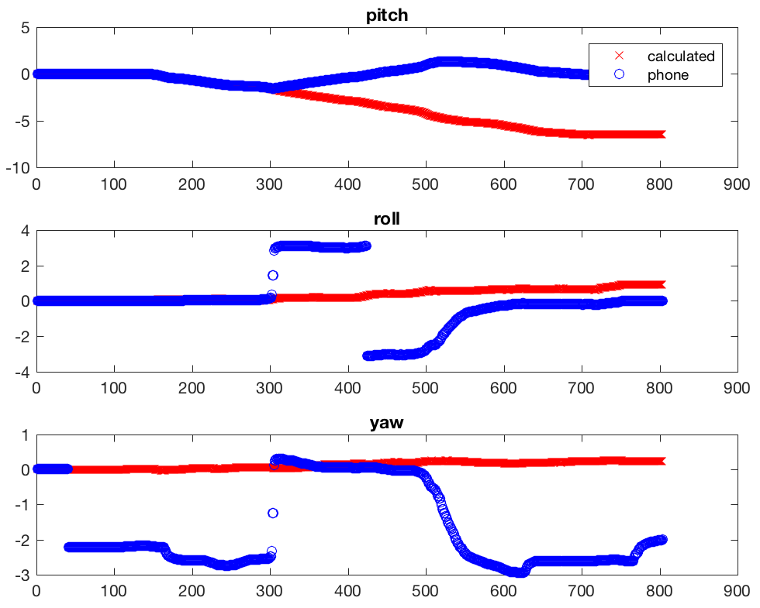
Dealing with Gimbal Lock
Notes:
Pitch – flipped phone forward (front down)

Slide 10
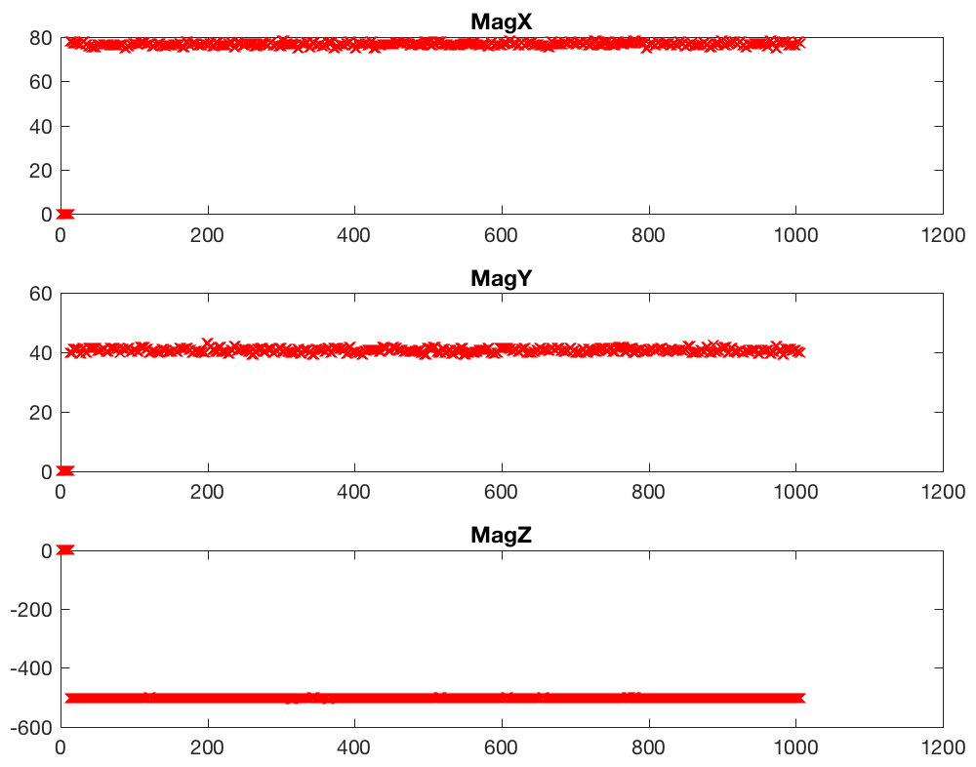
Magnets Do Weird Things
Notes:
Pitch – flipped phone forward (front down)

Slide 11
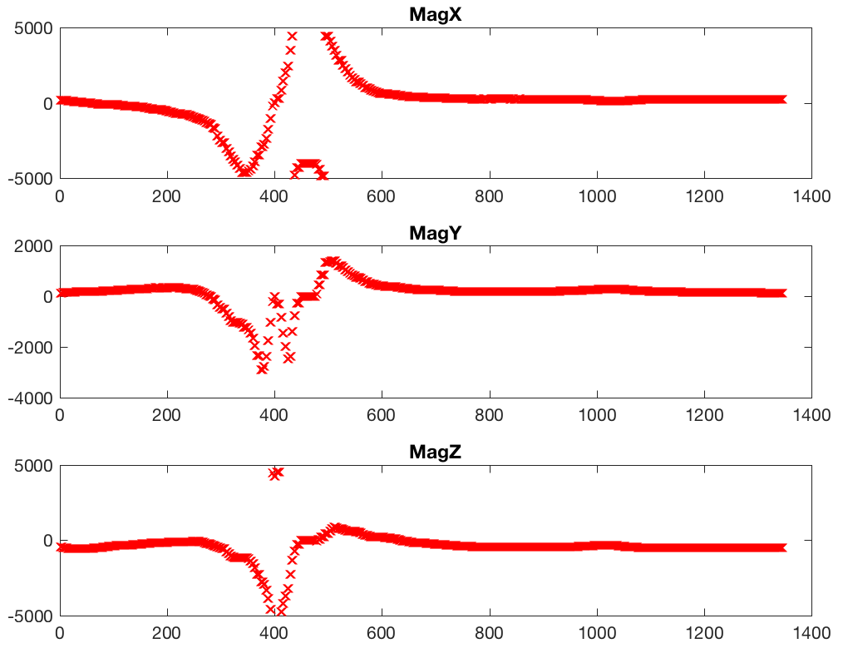
Magnets Do Weird Things
Notes:
Pitch – flipped phone forward (front down)

